Slide 1

E6156 – Cloud Computing:
Backend-as-a-Service
Lecture 6: DynamoDB, Lambda Functions, SNS, API Gateway
Donald F. Ferguson dff9@Columbia.edu
TRANSCENDING DISCIPLINES, TRANSFORMING LIVES

Slide 2

Content, Agenda
2 | E6156 – Cloud Computing: Backend-as-a-Service

Slide 3
Today’s Agenda
Class/project status
Questions and answers?
Data(bases)-as-a-Service
Concepts
Relational Data Service example and code
Environment variables
First look at 12 Factor Apps
Concepts
Environment
AWS Secrets and examples
DynamoDB concepts, overview, sample code.
Lambda functions concepts, overview, sample code.
Simple Notification Service concepts, overview, web hooks, Slack, sample code.
Some REST API concepts:
ETags
Asynchronous execution.
Putting the pieces together:
Registration and security.
Registration notification.
3 | E6156 – Cloud Computing: Backend-as-a-Service (Lecture 6)

Slide 4
Questions, Answers
4 | E6156 – Cloud Computing: Backend-as-a-Service

Slide 5
Class Status and Updates
5 | E6156 – Cloud Computing: Backend-as-a-Service

Slide 6
Class Status and Updates
Some statics:
Course has 125 registered students:
Section 001: 113 students
Attendance “On-Campus:” 27
Attendance “Online:” 84
Attendance “Unspecified:” 1
Section V01: 13
Milestone status report submissions:
Milestone 0: 108
Milestone 1: 37
Milestone 2: 33
Organizations:
I have added all teams that provided info on the account sheet to the organization.
There are 16 entries on the sheet, which seems low.
I would like to start holding meetings with teams.
6 | E6156 – Cloud Computing: Backend-as-a-Service (Lecture 6)

Slide 7
Database-as-a-Service RDS
7 | E6156 – Cloud Computing: Backend-as-a-Service

Slide 8
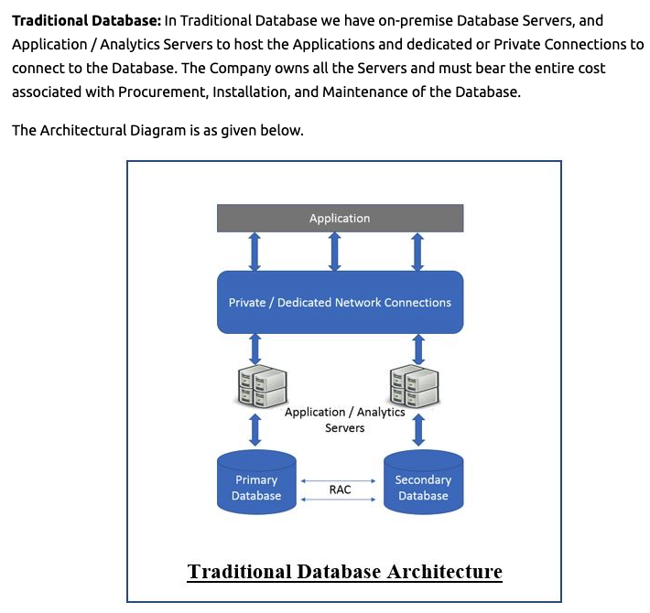
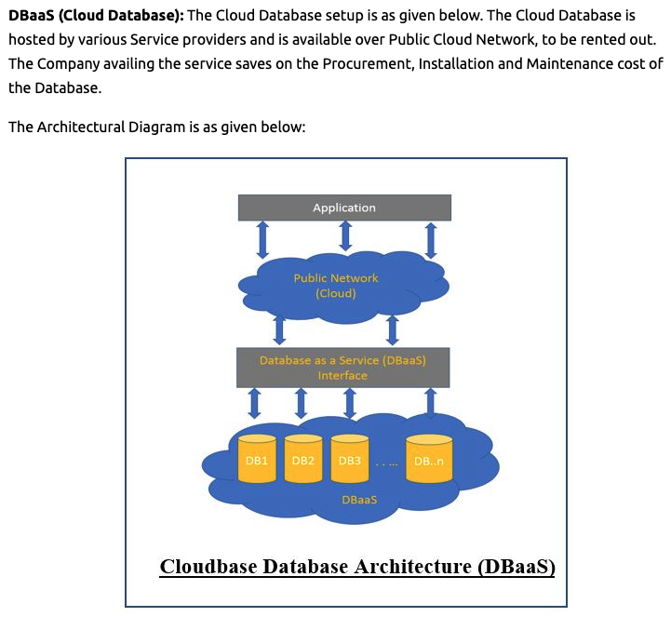
Database-as-a-Service
8 | E6156 – Cloud Computing: Backend-as-a-Service (Lecture 6)

Slide 9
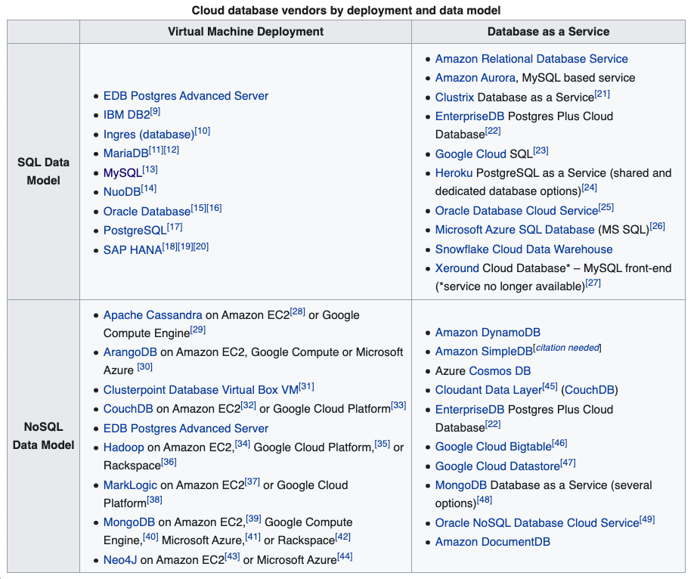
Database-as-a-Service
9 | E6156 – Cloud Computing: Backend-as-a-Service (Lecture 6)

Slide 10
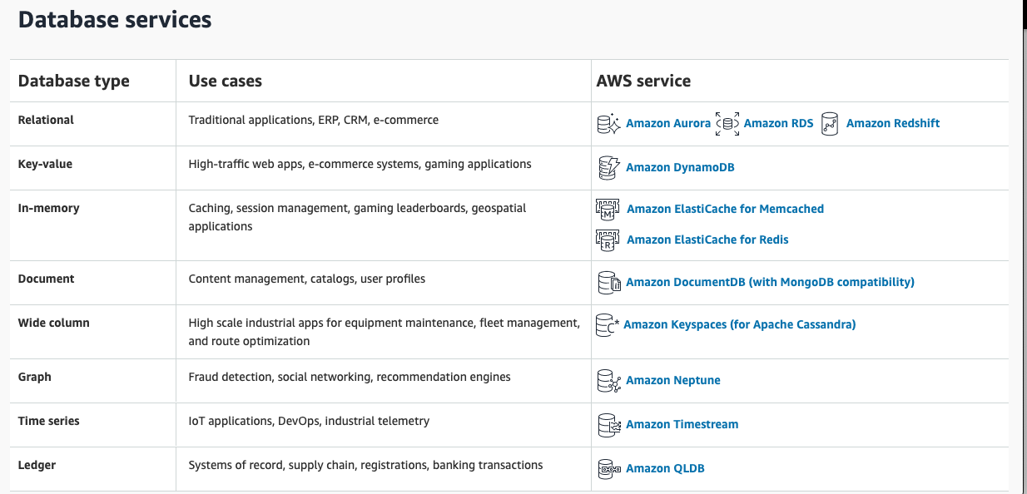
Database-as-a-Service
AWS DBaaS; Microsoft, Google and others have similar capabilities.
10 | E6156 – Cloud Computing: Backend-as-a-Service (Lecture 6)

Slide 11
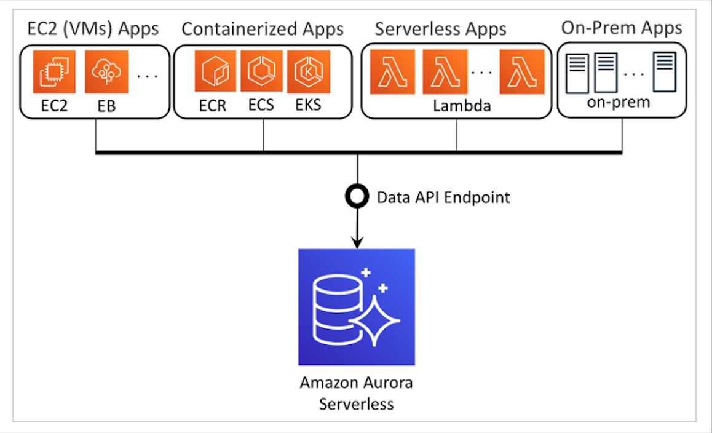
Database-as-a-Service – Aurora Concept
AWS Aurora is Database-as-a-Service
AWS Relational is somewhere between
Database-as-a-Service
Cloud Delivered DB via VMs.
We will start with RDS; I had set up issues with Aurora
11 | E6156 – Cloud Computing: Backend-as-a-Service (Lecture 6)

Slide 12
Demo/Samples
Demonstrate provisioning an instance. – RDS
MySQL Workbench
Concept of environment variables.
Demonstrate simple code. – rdsexample.py in the repo
12 | E6156 – Cloud Computing: Backend-as-a-Service (Lecture 6)

Slide 13
12 Factor Apps
AWS Secrets
13 | E6156 – Cloud Computing: Backend-as-a-Service

Slide 14
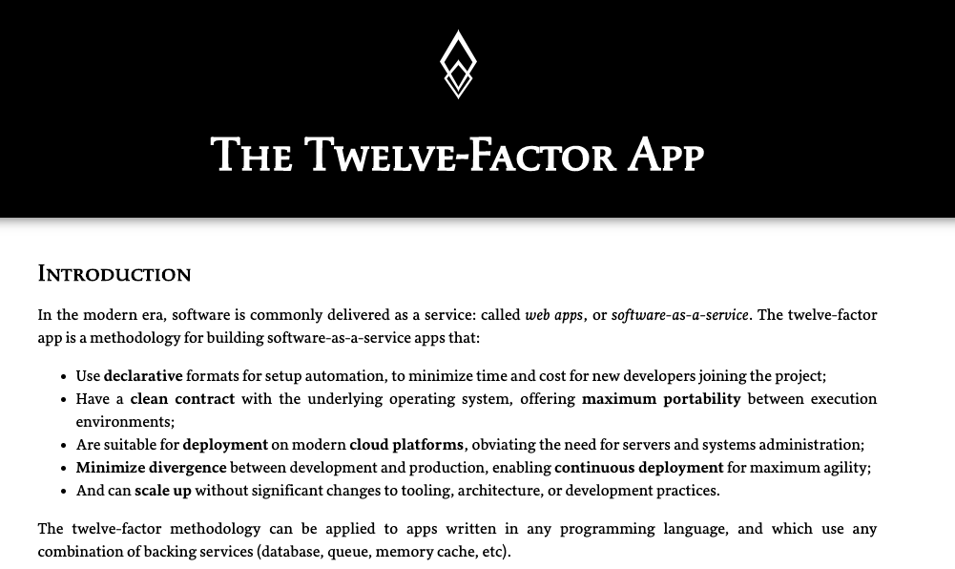
An Aside – 12 Factor Applications
14 | E6156 – Cloud Computing: Backend-as-a-Service (Lecture 6)

Slide 15
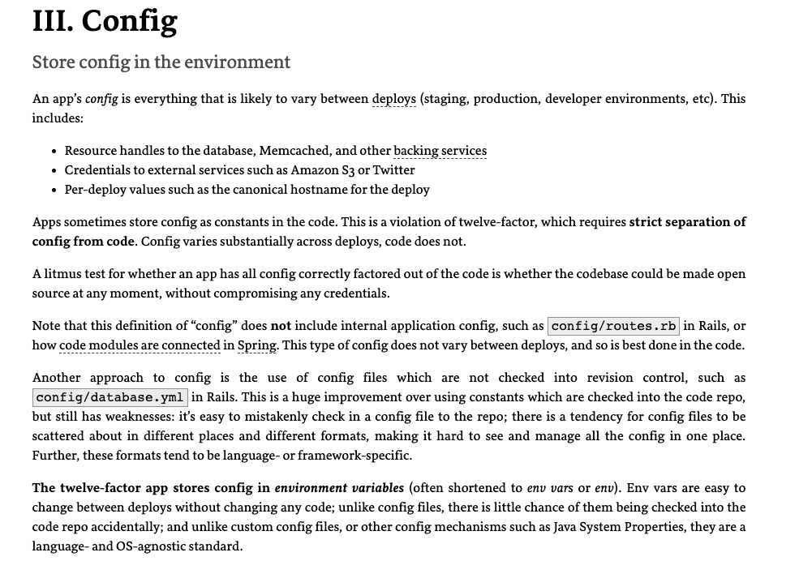
An Aside – 12 Factor Applications: Factor 3
15 | E6156 – Cloud Computing: Backend-as-a-Service (Lecture 6)

Slide 16
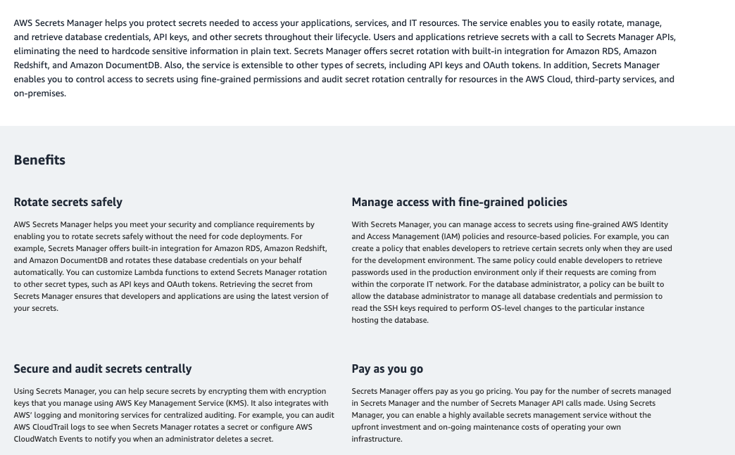
What if I have a lot of stuff in a lot of places?
Environment variables can be hard to manage in large, dynamic environments.
There are cloud services that provide capabilities.
This is an evolution of existing on-premise approaches to managing:
Keys.
Config information.
etc.
16 | E6156 – Cloud Computing: Backend-as-a-Service (Lecture 6)

Slide 17
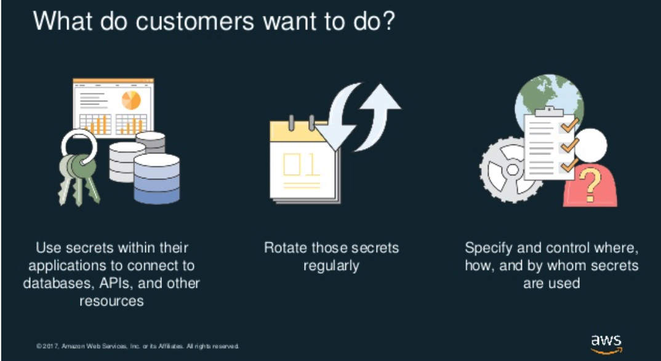
AWS Secrets Manager
https://www.slideshare.net/AmazonWebServices/understanding-aws-secrets-manager-aws-online-tech-talks
17 | E6156 – Cloud Computing: Backend-as-a-Service (Lecture 6)

Slide 18
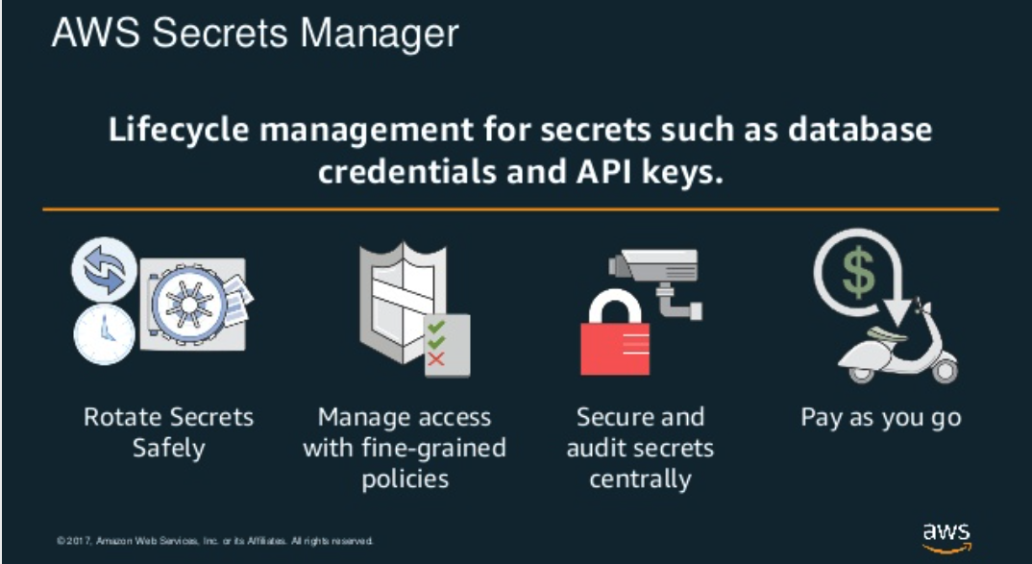
AWS Secrets Manager
https://www.slideshare.net/AmazonWebServices/understanding-aws-secrets-manager-aws-online-tech-talks
18 | E6156 – Cloud Computing: Backend-as-a-Service (Lecture 6)

Slide 19
Demo/Samples
Walkthrough of setting up secrets.
IAM, roles, API keys, etc.
Code example.
Page through SlideShare slides.
19 | E6156 – Cloud Computing: Backend-as-a-Service (Lecture 6)

Slide 20
DynamoDB Introduction and Examples
20 | E6156 – Cloud Computing: Backend-as-a-Service

Slide 21
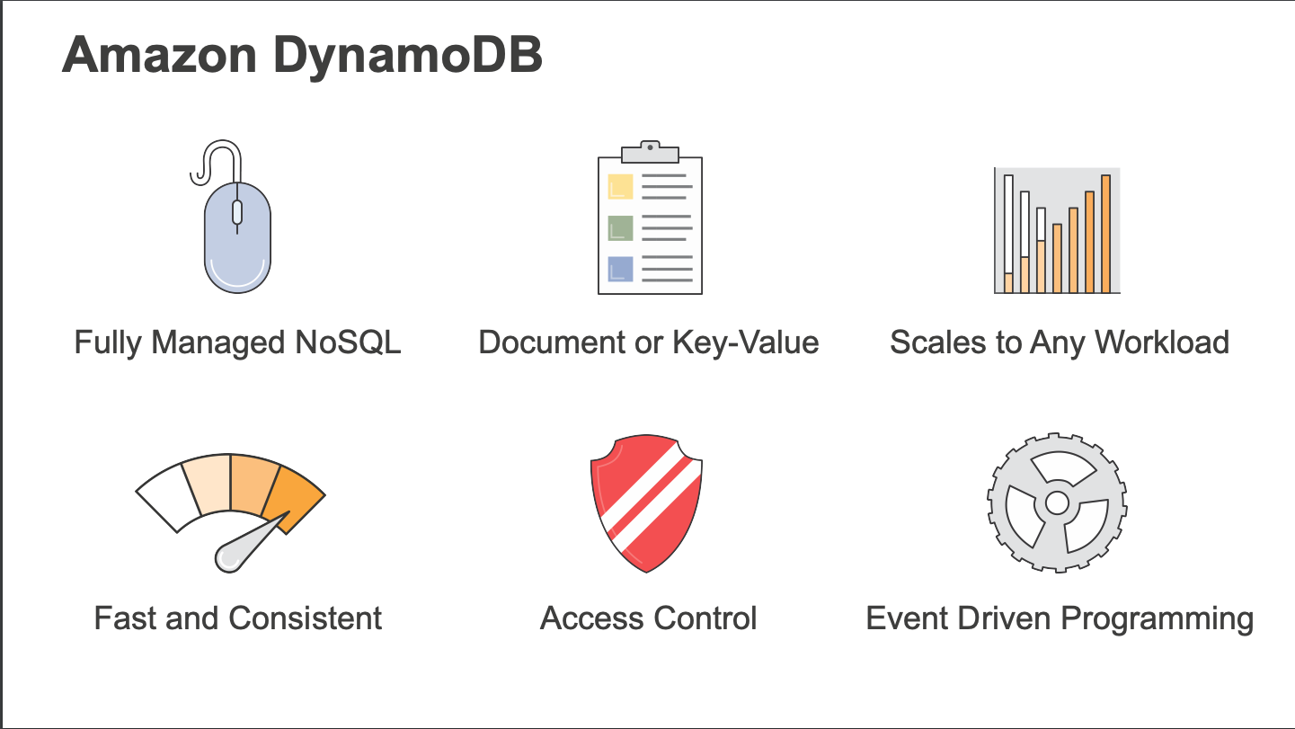
DynamoDB
21 | E6156 – Cloud Computing: Backend-as-a-Service (Lecture 6)

Slide 22
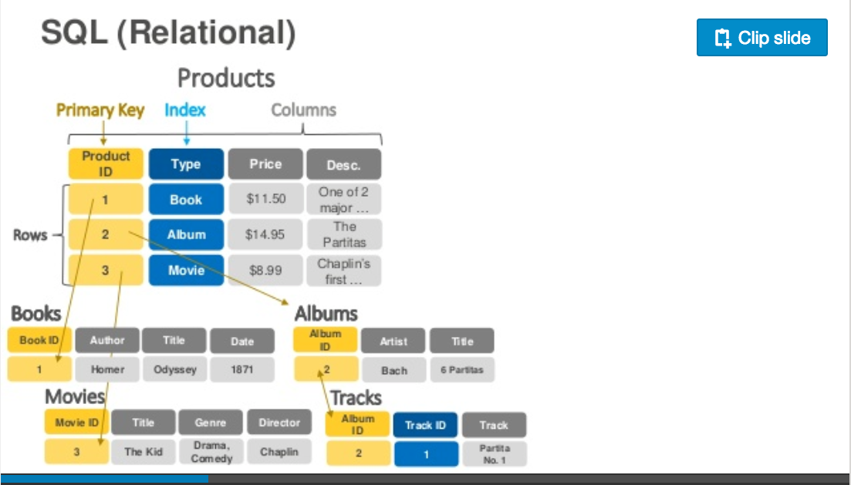
Relational Data Model
https://www.slideshare.net/AmazonWebServices/introduction-to-amazon-dynamodb-73191648
22 | E6156: Topics in SW Engineering – Cloud Computing/BaaS

Slide 23
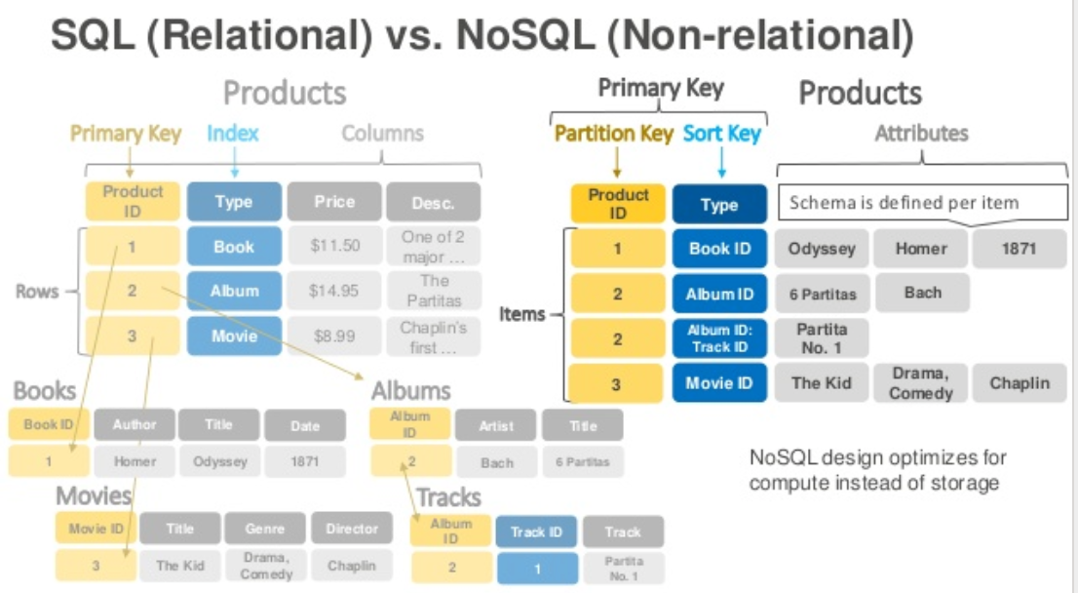
DynamoDB Model
23 | E6156: Topics in SW Engineering – Cloud Computing/BaaS

Slide 24
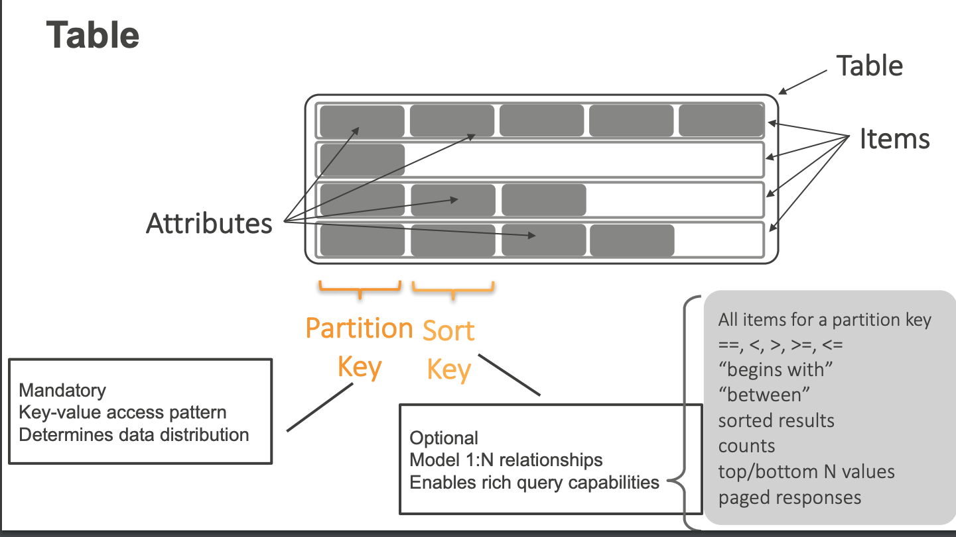
DynamoDB Model
24 | E6156: Topics in SW Engineering – Cloud Computing/BaaS

Slide 25
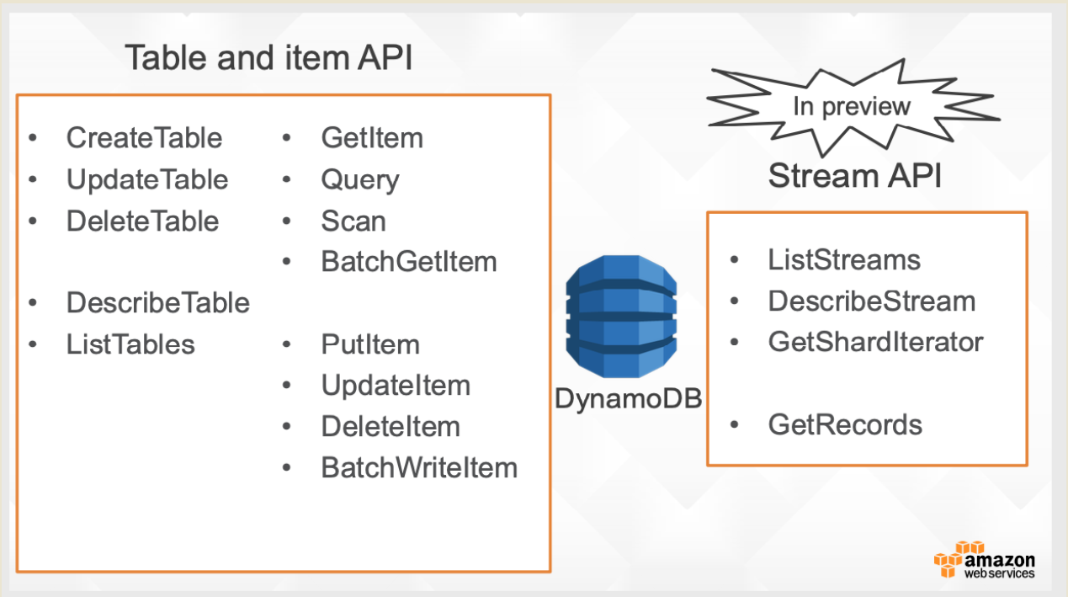
DynamoDB Model
25 | E6156: Topics in SW Engineering – Cloud Computing/BaaS

Slide 26
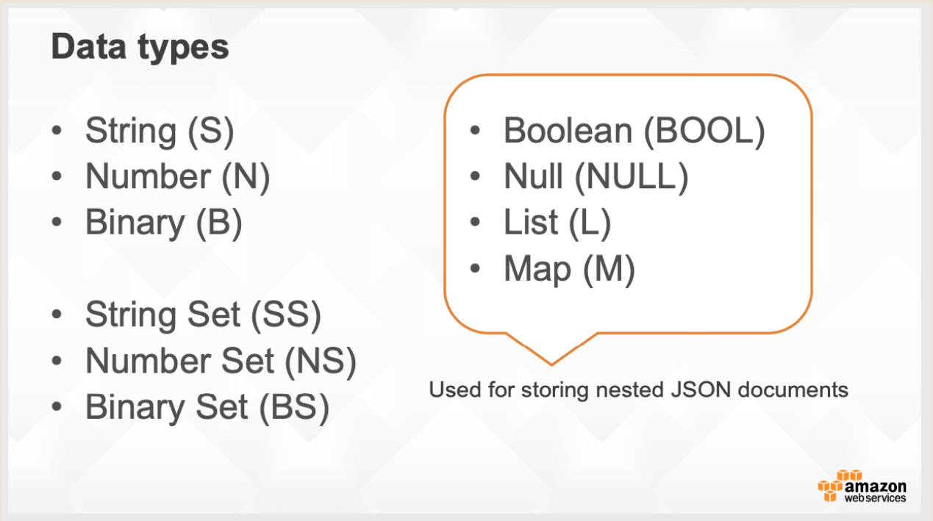
DynamoDB Model
26 | E6156: Topics in SW Engineering – Cloud Computing/BaaS

Slide 27
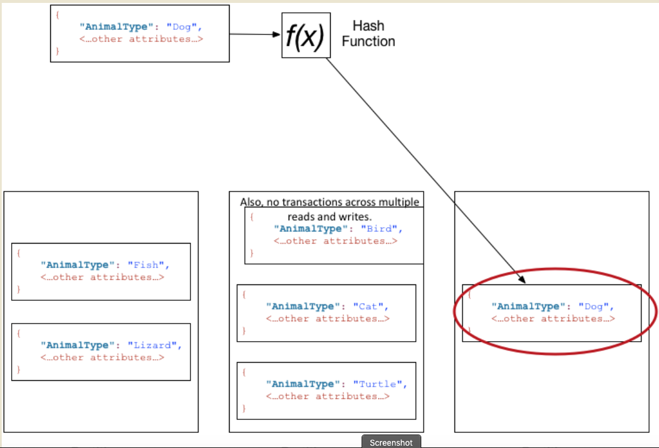
DynamoDB Model
27 | E6156: Topics in SW Engineering – Cloud Computing/BaaS

Slide 28
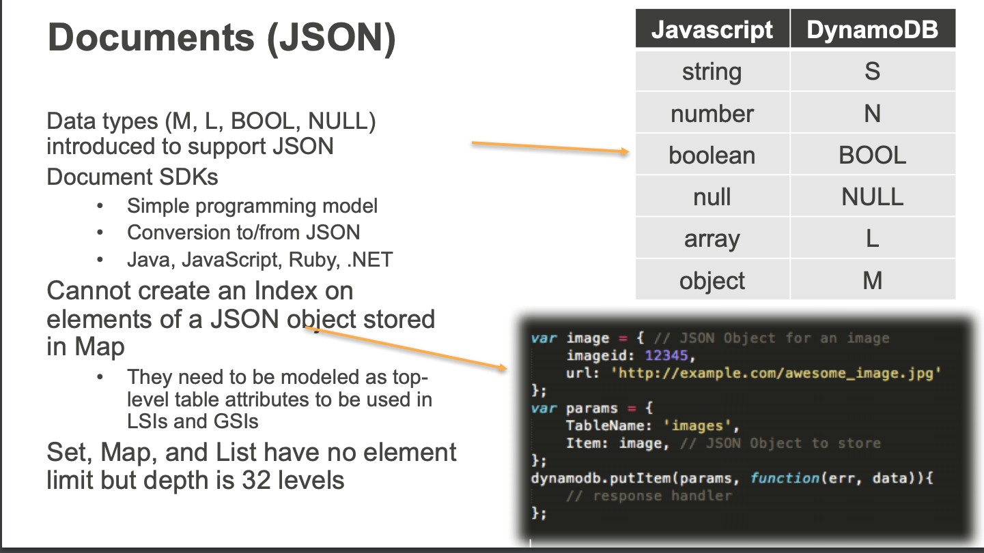
DynamoDB Model
28 | E6156: Topics in SW Engineering – Cloud Computing/BaaS

Slide 29
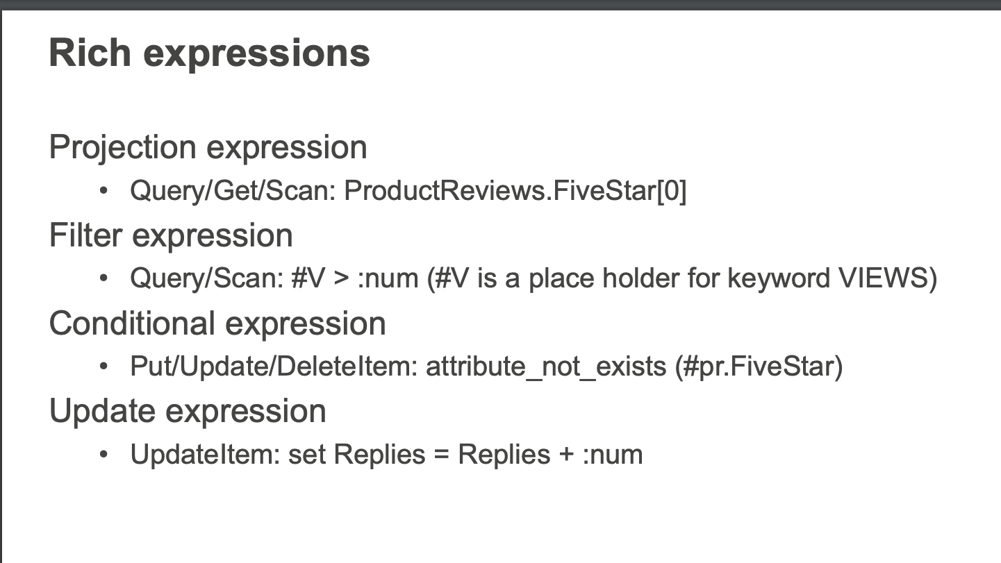
DynamoDB Model
29 | E6156: Topics in SW Engineering – Cloud Computing/BaaS

Slide 30
Shared Everything Shared Nothing
30 | E6156 – Cloud Computing: Backend-as-a-Service

Slide 31
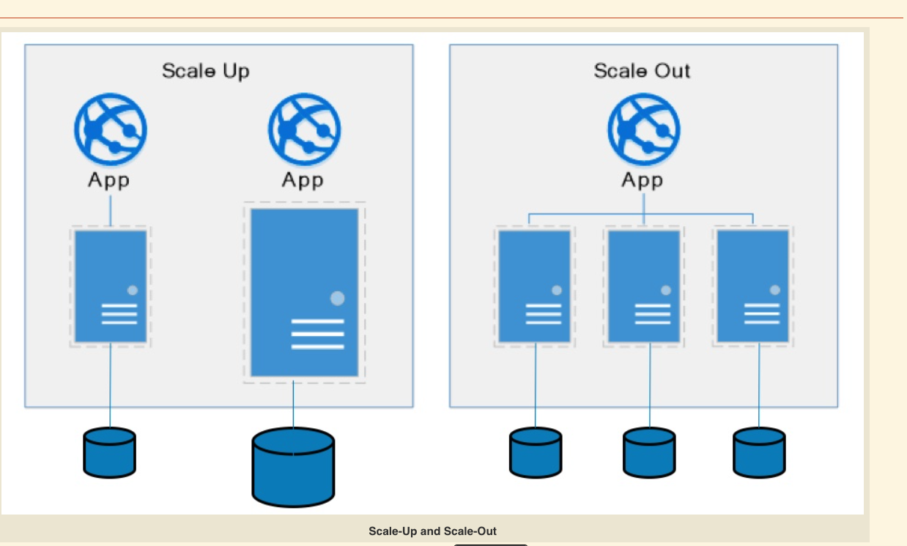
Some Database Concepts
31 | E6156: Topics in SW Engineering – Cloud Computing/BaaS

Slide 32
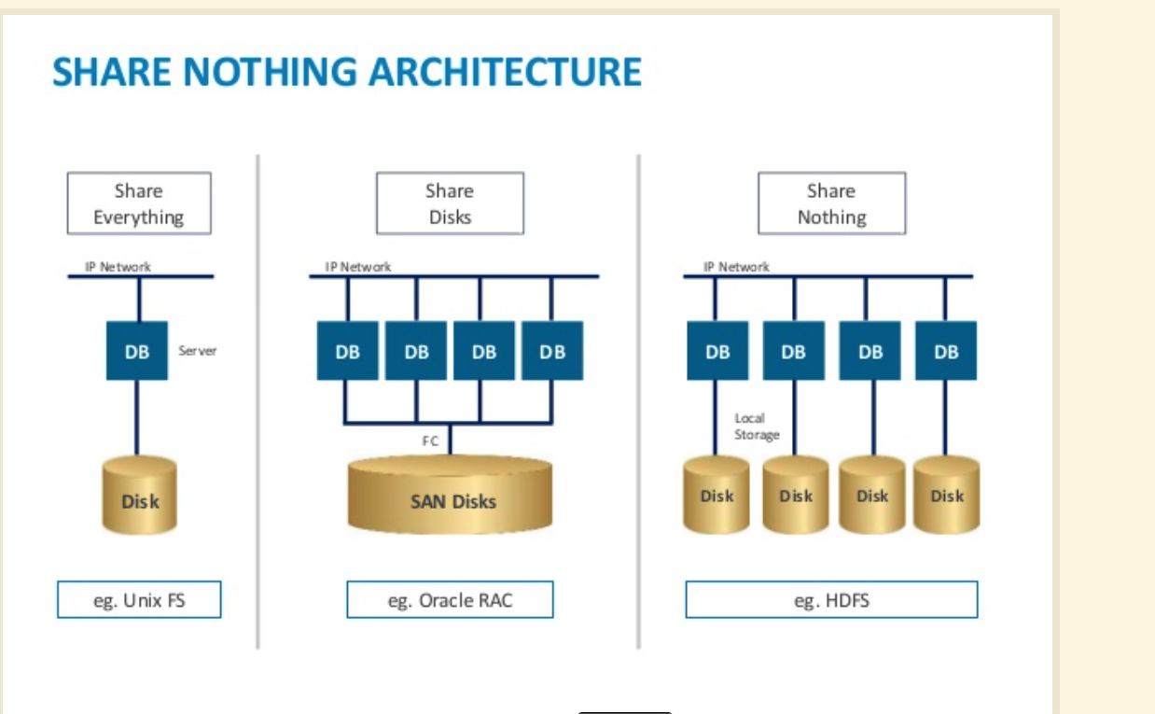
Some Database Concepts
32 | E6156: Topics in SW Engineering – Cloud Computing/BaaS

Slide 33
Function-as-a-Service Lambda Functions
33 | E6156 – Cloud Computing: Backend-as-a-Service

Slide 34
Terminology and Definitions Stolen from theWeb
Serverless computing is a cloud computing execution model in which the cloud provider runs the server, and dynamically manages the allocation of machine resources. Pricing is based on the actual amount of resources consumed by an application, rather than on pre-purchased units of capacity.^{[1]} It can be a form of utility computing. Serverless computing can simplify the process of deploying code into production. Scaling, capacity planning and maintenance operations may be hidden from the developer or operator. Serverless code can be used in conjunction with code deployed in traditional styles, such as microservices. Alternatively, applications can be written to be purely serverless and use no provisioned servers at all.^{[2]} This should not be confused with computing or networking models that do not require an actual server to function, such as peer-to-peer (P2P).”
Function as a service (FaaS) is a category of cloud computing services that provides a platform allowing customers to develop, run, and manage application functionalities without the complexity of building and maintaining the infrastructure typically associated with developing and launching an app.^{[1]} Building an application following this model is one way of achieving a "serverless" architecture, and is typically used when building microservices applications.”
That was baffling:
IaaS, CaaS – You control the SW stack and the cloud provides (virtual) HW.
PaaS – The cloud hides the lower layer SW and provides an application container (e.g. Flask) with “Your code goes here.” You are aware of container.
FaaS – The cloud provides the container, and you implement functions (corresponding to routes in REST).
34 | E6156 – Cloud Computing: Backend-as-a-Service (Lecture 6)

Slide 35
Serverless/Function-as-a-Service
https://medium.com/@tanmayct/serverless-architecture-function-as-a-service-19e127b8c990
35 | E6156 – Cloud Computing: Backend-as-a-Service (Lecture 6)

Slide 36
Two Perspectives on this Stuff
36 | E6156 – Cloud Computing: Backend-as-a-Service (Lecture 6)

Slide 37









What is Serverless good for?
Serverless is good for
short-running
stateless
event-driven
Serverless is not good for
long-running
stateful
number crunching
Microservices
Databases
Mobile Backends
Deep Learning Training
Bots, ML Inferencing
Heavy-Duty Stream Analytics
IoT
f(x)
Numerical Simulation
Modest Stream Processing
Video Streaming
Service integration
https://www.serverlesscomputing.org/wosc3/presentations/intro.pptx

Slide 38

What triggers code execution?
Runs code in response to events
Event-programming model
Notes:
What is Serverless

Slide 39



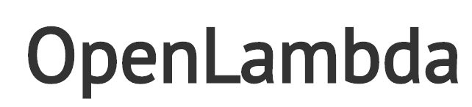



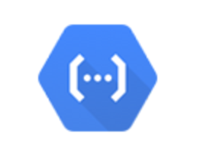



Current Platforms for Serverless
AWS Lambda
Azure Functions
Kubernetes
IBM Cloud Functions
Red-Hat
Google Functions
Notes:
Auth0, Twitter, ..
And many more upcoming / open source

Slide 40
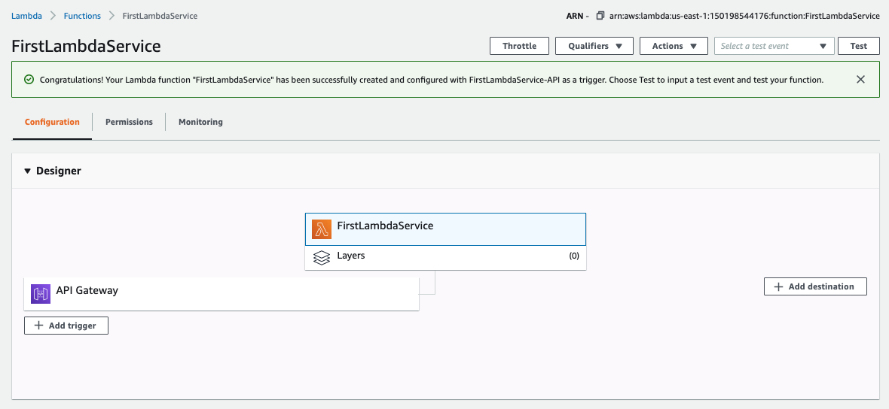
Lambda Function
40 | E6156: Topics in SW Engineering – Cloud Computing/BaaS

Slide 41
Lambda Function
41 | E6156: Topics in SW Engineering – Cloud Computing/BaaS

Slide 42
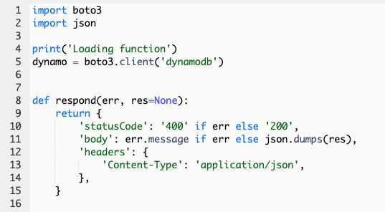
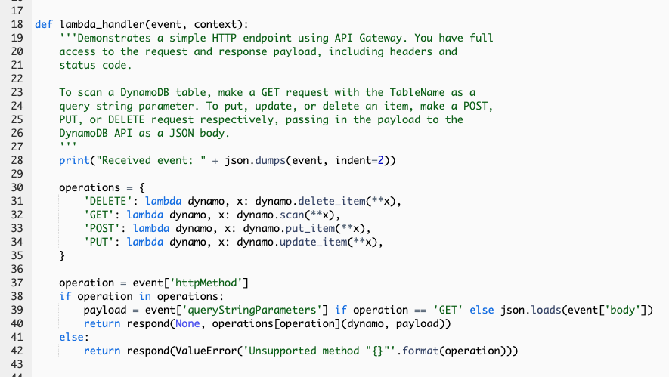
Lambda Function
42 | E6156: Topics in SW Engineering – Cloud Computing/BaaS

Slide 43
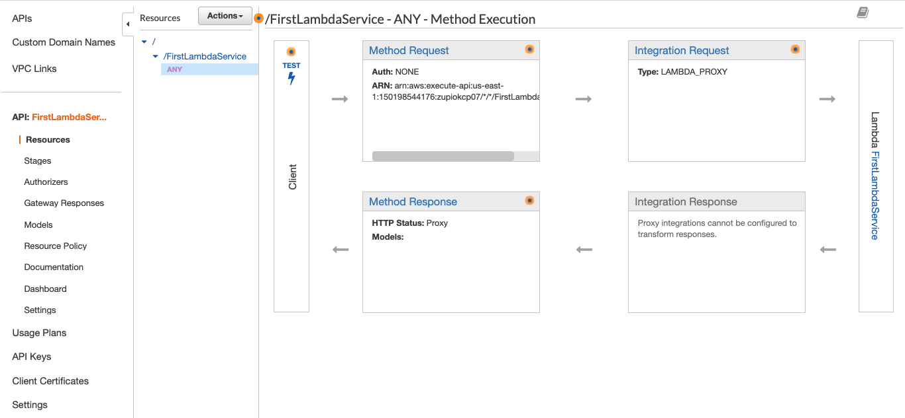
API Gateway Event
43 | E6156: Topics in SW Engineering – Cloud Computing/BaaS

Slide 44
Demo/Samples
Let’s take it for a spin.
44 | E6156 – Cloud Computing: Backend-as-a-Service (Lecture 6)

